Slide 1
Vote Aspen Falls
Increase The Vote Campaign, By Maria Martinez
Get out and vote!

Slide 2

Voter Information
Who is qualified to vote
  Resident for minimum of 28 days
  US citizen
  At least 18 years of age
  Registered or registering

Slide 3
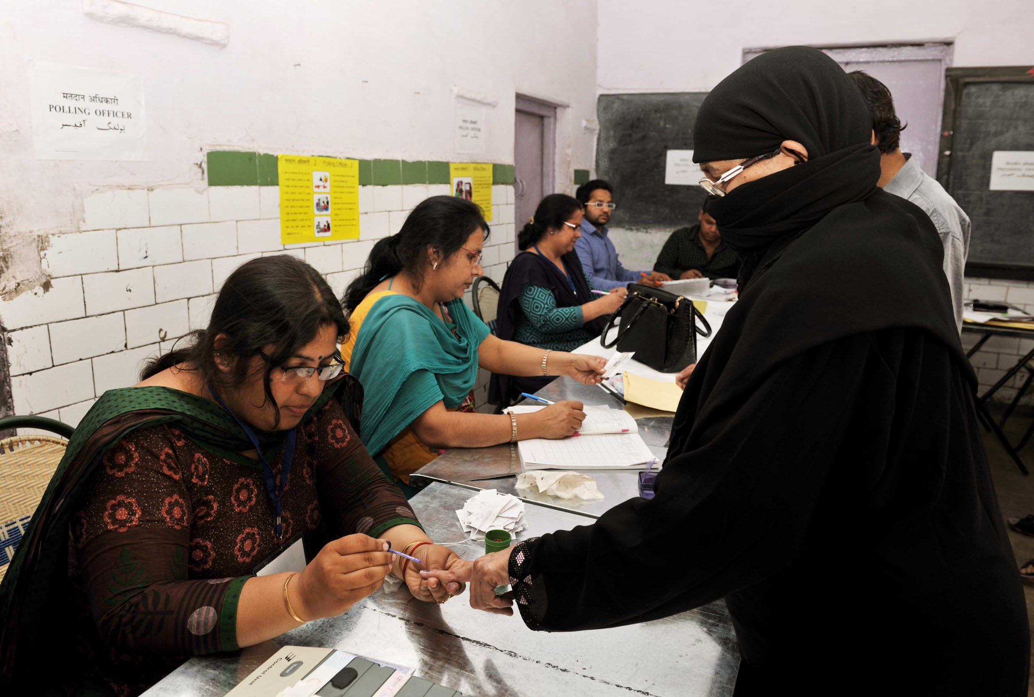
Poll Location
Aspen Falls City Hall
500 S Aspen St, Aspen Falls, CA

Slide 4
Elections
Spring Primary | Spring Election
Partisan Primary | General Election

Slide 5
Voter Demographics

